Slide 1
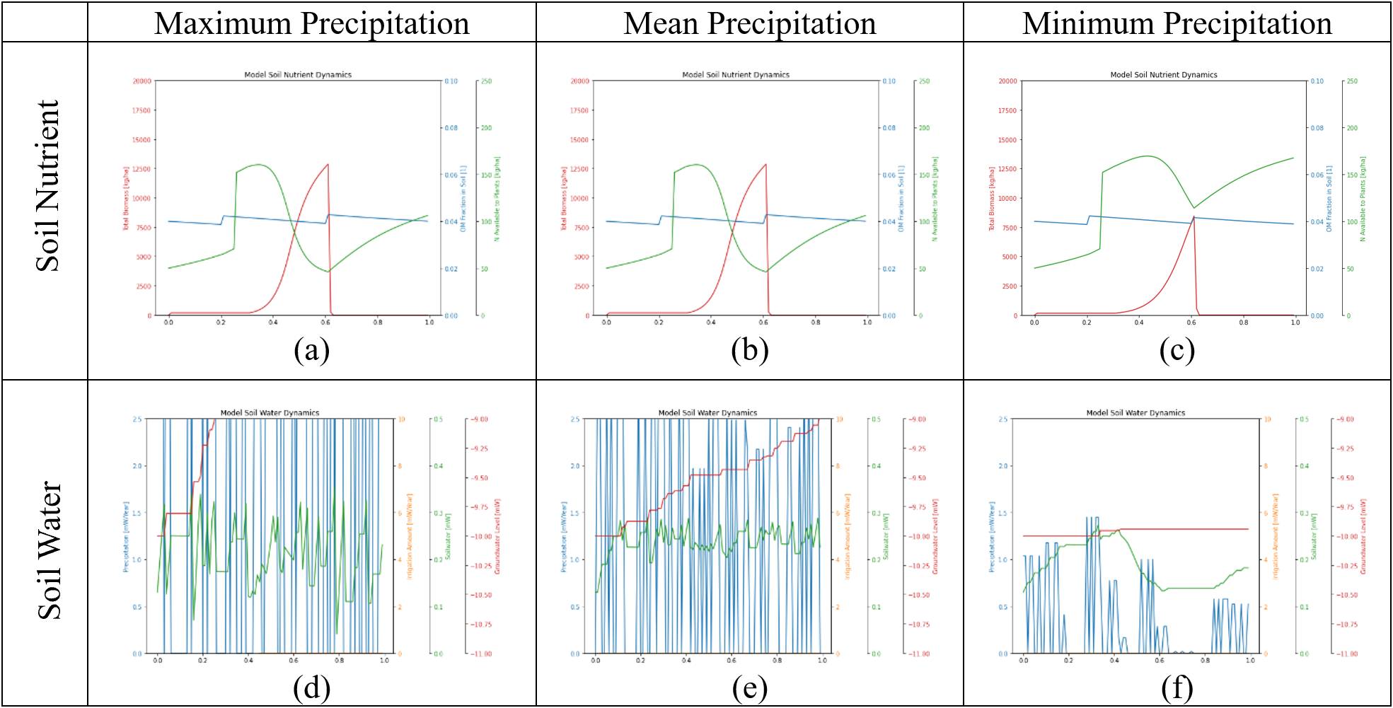
Model Soil Nutrient Dynamics
Model Soil Nutrient Dynamics
Model Soil Nutrient Dynamics
Total biomass [kg/ha]
OM fraction in soil [1]
OM fraction in soil [1]
OM fraction in soil [1]
Total biomass [kg/ha]
Total biomass [kg/ha]
N available to plants [kg/ha]
N available to plants [kg/ha]
N available to plants [kg/ha]
Model Soil Water Dynamics
Model Soil Water Dynamics
Model Soil Water Dynamics
Irrigation [mW/Year]
Irrigation [mW/Year]
Irrigation [mW/Year]
Precipitation [mW/Year]
Soilwater [mW/mSoil]
Precipitation [mW/Year]
Soilwater [mW/mSoil]
Precipitation [mW/Year]
Soilwater [mW/mSoil]
Groundwater level [mW]
Groundwater level [mW]
Groundwater level [mW]

Slide 2
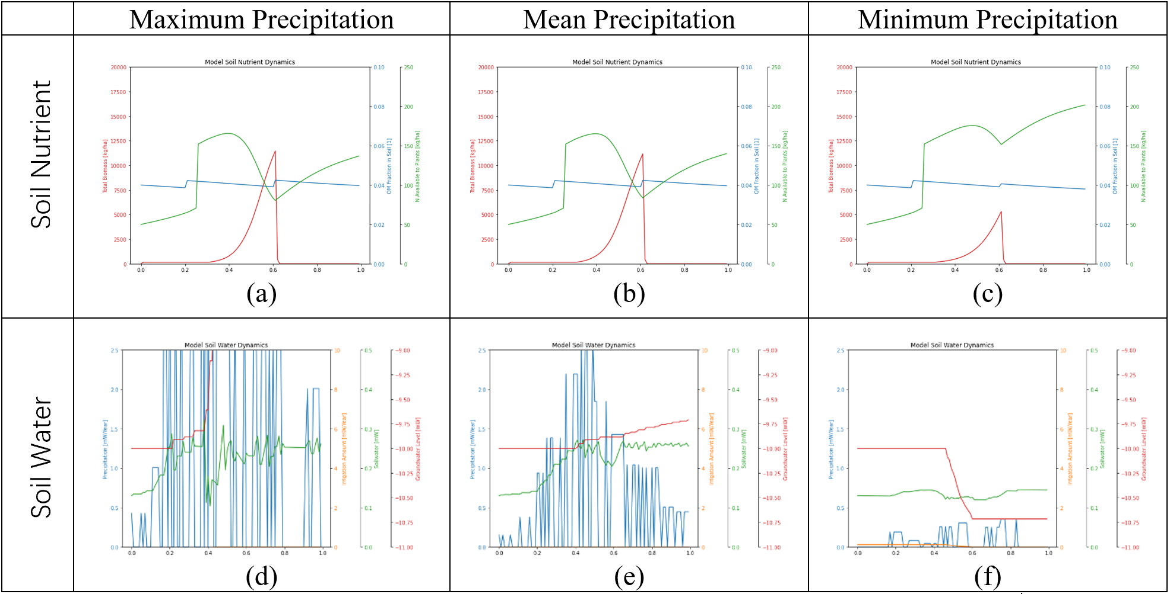
Model Soil Nutrient Dynamics
Model Soil Nutrient Dynamics
Model Soil Nutrient Dynamics
Total biomass [kg/ha]
OM fraction in soil [1]
OM fraction in soil [1]
OM fraction in soil [1]
Total biomass [kg/ha]
Total biomass [kg/ha]
N available to plants [kg/ha]
N available to plants [kg/ha]
N available to plants [kg/ha]
Irrigation [mW/Year]
Irrigation [mW/Year]
Model Soil Water Dynamics
Model Soil Water Dynamics
Model Soil Water Dynamics
Soilwater [mW/mSoil]
Irrigation [mW/Year]
Soilwater [mW/mSoil]
Groundwater level [mW]
Soilwater [mW/mSoil]
Groundwater level [mW]
Precipitation [mW/Year]
Precipitation [mW/Year]
Precipitation [mW/Year]
Groundwater level [mW]

